Slide 1


Basic Java Refresher
ITP64 Integrative Programming and Technologies 1

Slide 2
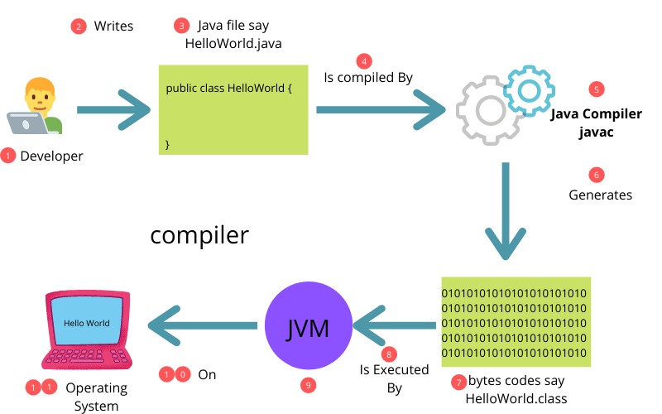
How Java Works

Slide 3
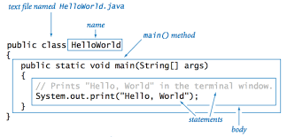
Java Program Structure

Slide 4
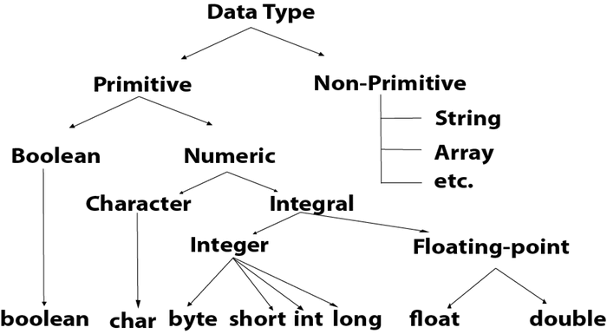
Java Data Types

Slide 5
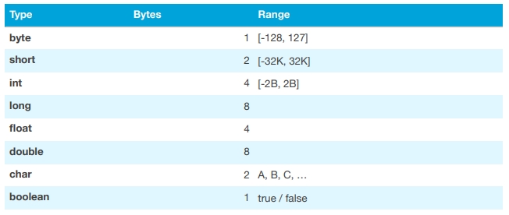
Java Primitive Data Type

Slide 6
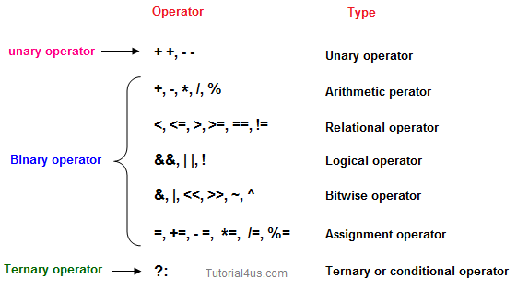
Java Operators and Precedence

Slide 7
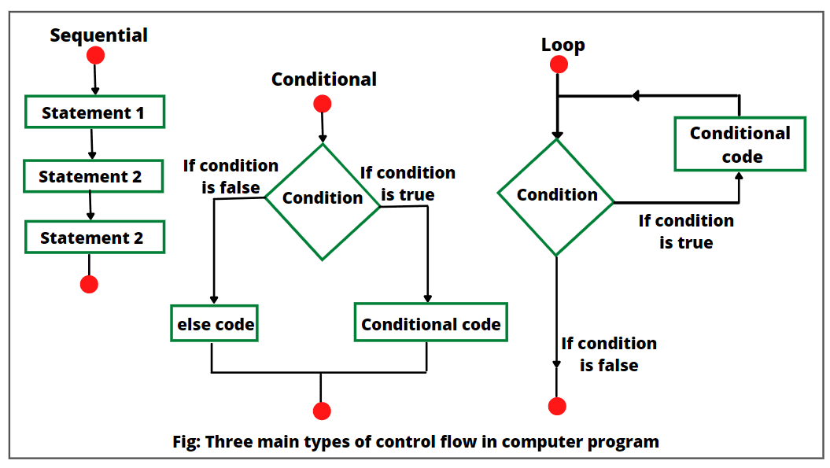
Control Structures

Slide 8
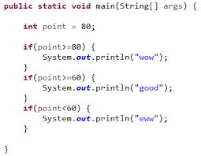
Conditional
Control Structures

Slide 9
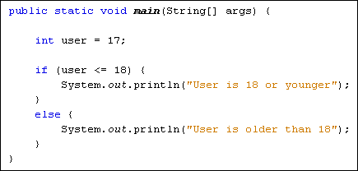
Conditional
Control Structures

Slide 10
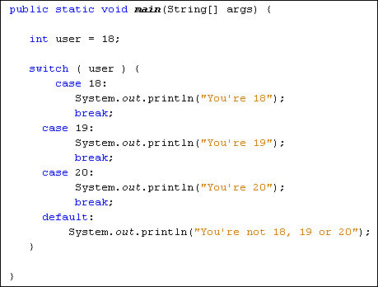
Conditional
Control Structures

Slide 11
for(int i=1; i<=input; i++) {
sum = sum + i;
}
Repetitive Control Structure

Slide 12
int i=1;
while(i<=input) {
sum = sum + i;
i++;
}
Repetitive Control Structure

Slide 13
int i=1;
do {
sum = sum + i;
i++;
} while(i<=input);
Repetitive Control Structure

Slide 14
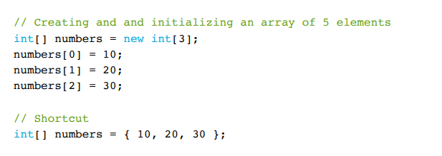
Arrays

Slide 15
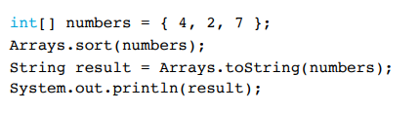
Array Class

Slide 16
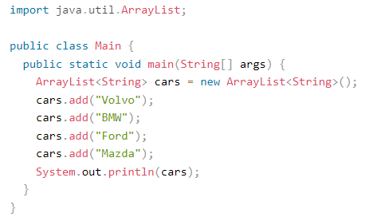
Array List

Slide 17
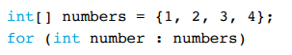
for-each Loop

Slide 18
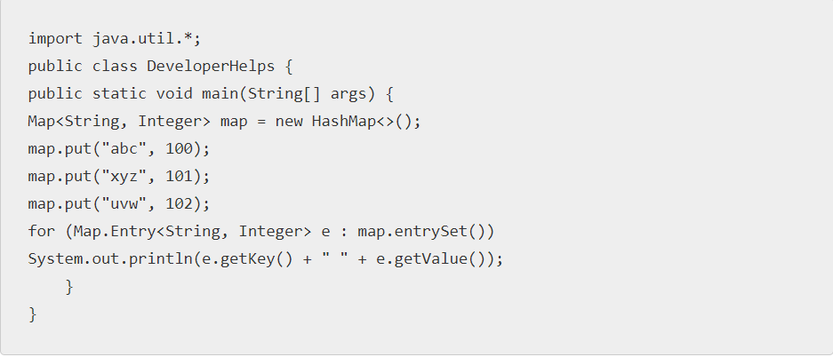
Maps

Slide 19
String
String values are called string literals
String class is defined in java.lang packed which is automatically imported
String is a reference type (non-primitive type) which needs to be instantiated and initialized but not using the new operator but shorthand instead.
+ operator can be used to concatenate strings
In java, strings are immutable, meaning they cannot be changed so any method that modifies a string returns a new string

Slide 20
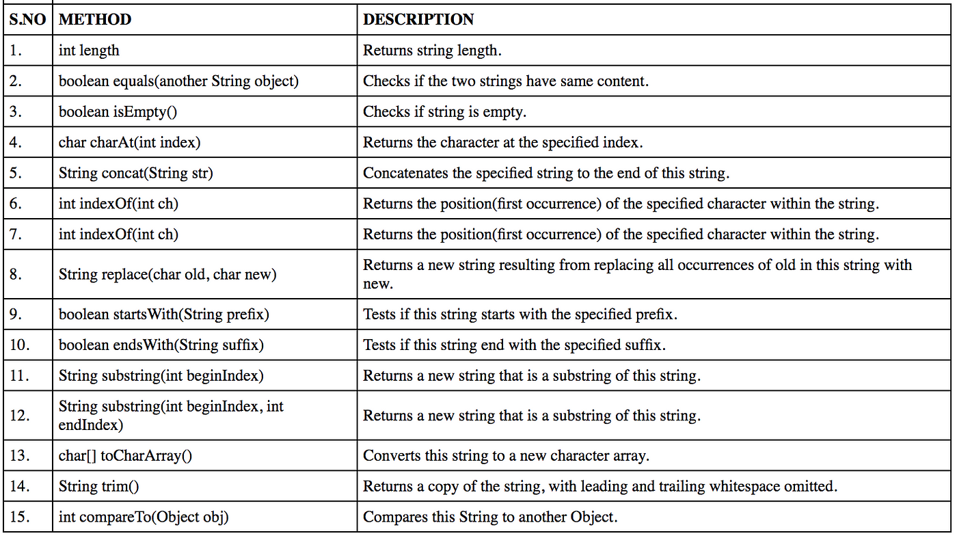
String
String name = “John”;

Slide 21
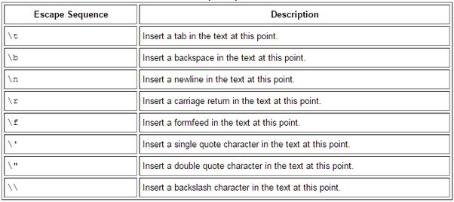
Escape Sequences

Slide 22
Java Constants
final double pi = 3.1416;

Slide 23
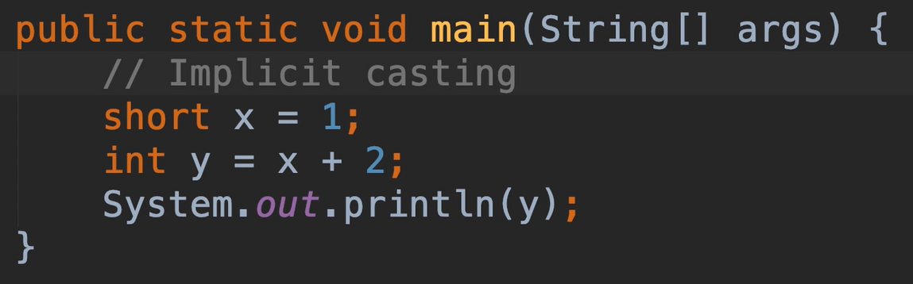
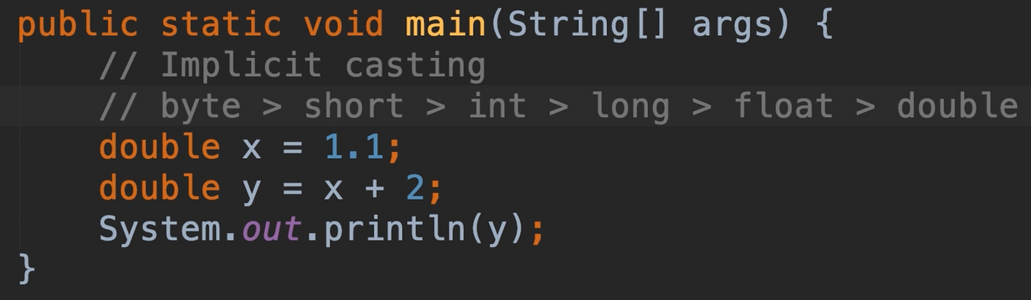
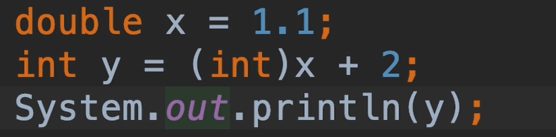
Casting

Slide 24
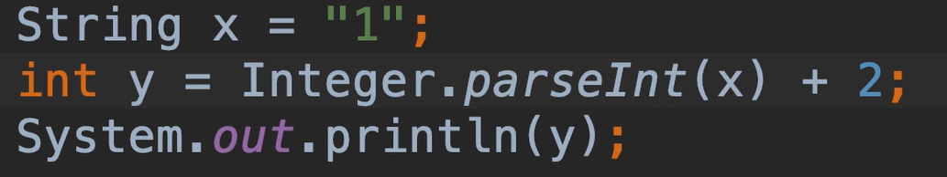
Wrapper Classes

Slide 25
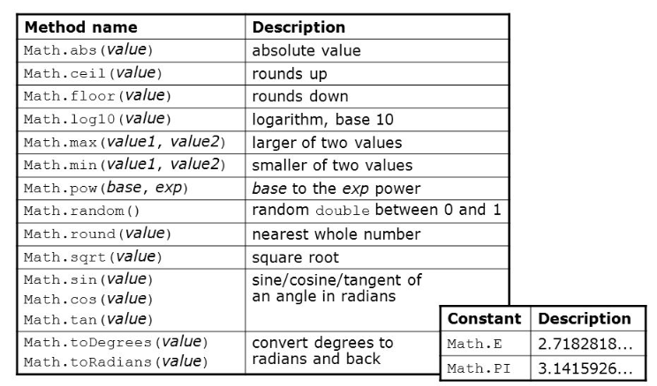
java.lang.Math class

Slide 26
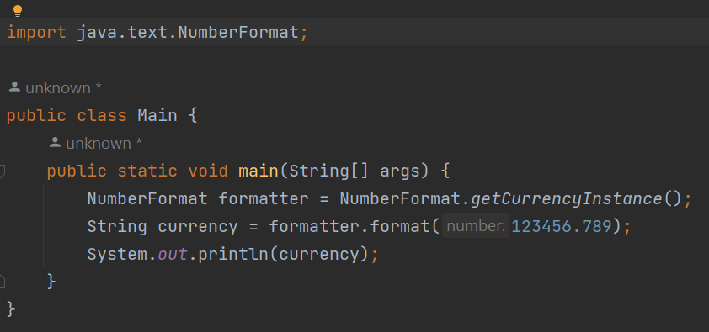
NumberFormatter class

Slide 27
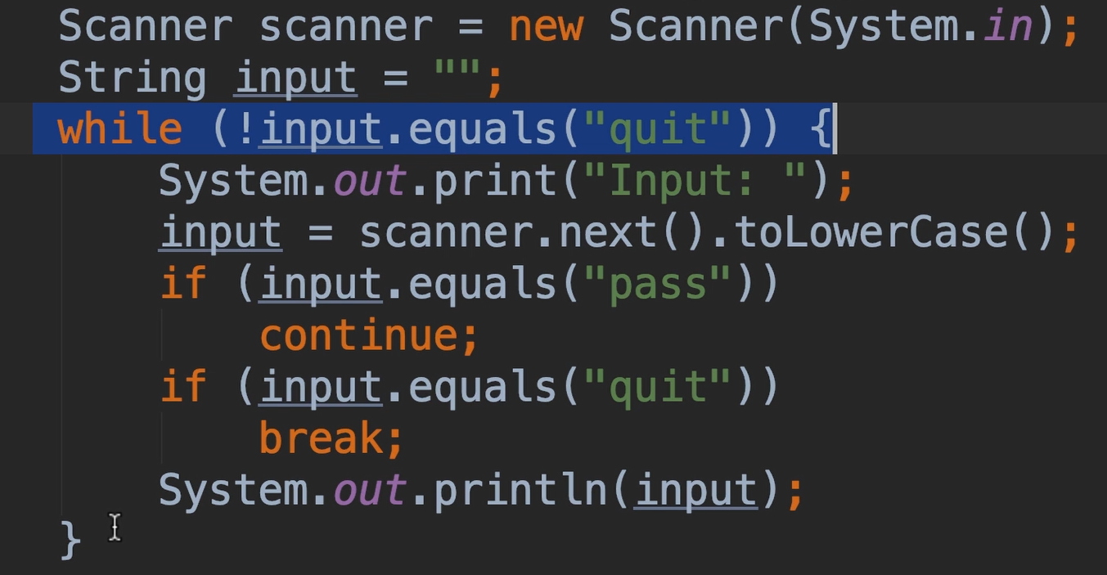
break and continue statements

Slide 28
Error Types
Compile-time errors - errors that prevents from running the program
Syntax errors
no semi-colon at the end of the statement
missing parenthesis
missing curly braces
Run-time errors - errors that are detected during program execution
Exceptions

Slide 29
THANK YOU

